Slide 1


Building microservices with .NET and Dapr
Company/speaker
Presentation title
12 May 2022 - Carl in ’t Veld - CloudNation
#teqnation2021

Slide 2


Contents
Who am I
Dapr – the why and the what
Play with Dapr sidecar
Blazor sample app
Deploy to Azure Kubernetes Service
Diagnostics
Service Mesh versus Dapr
Roadmap
Getting started

Slide 3
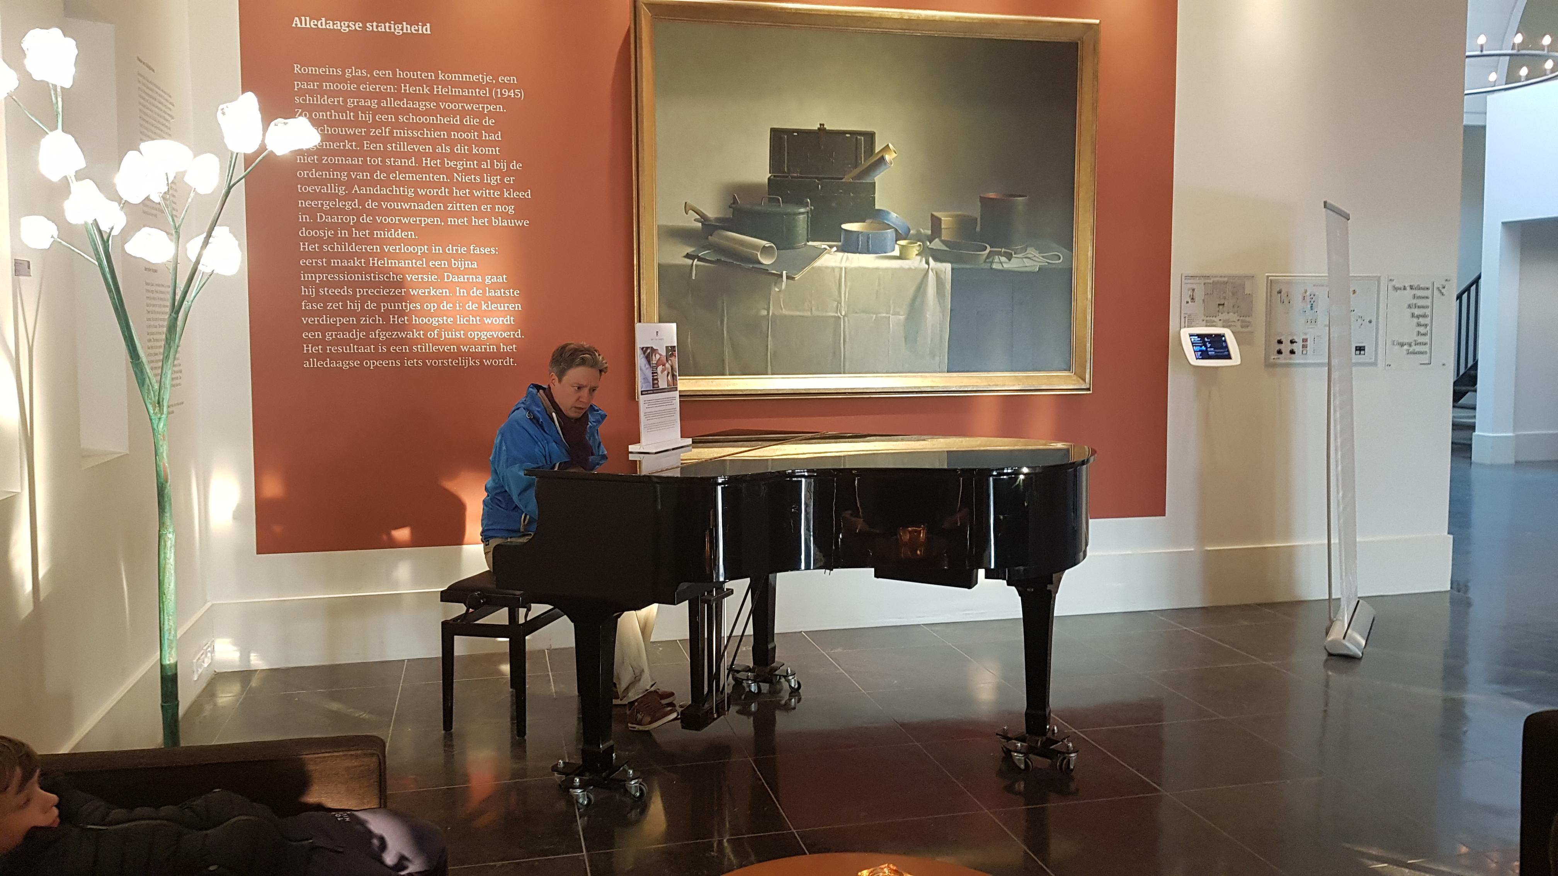

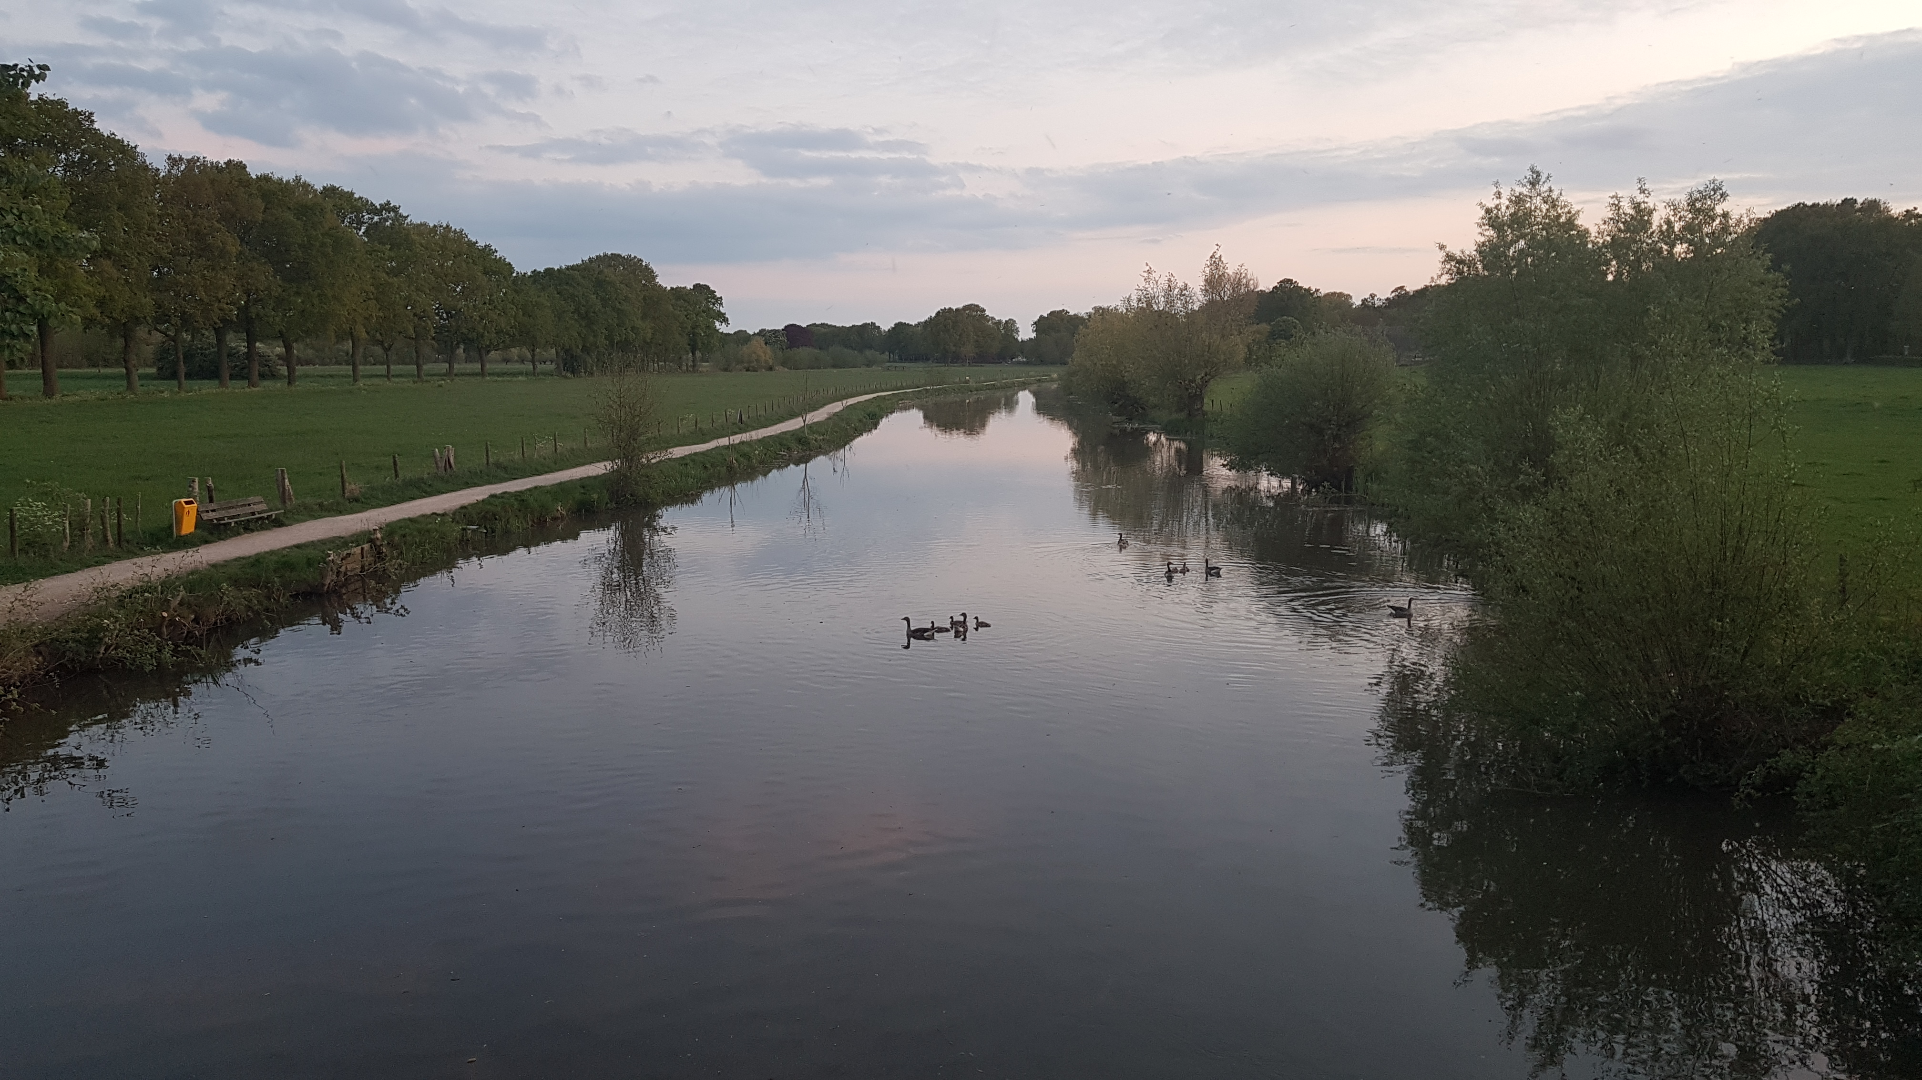
Who am I
Carl in ’t Veld
20 years industry experience
Multiple years .NET lead engineer
Multiple years Azure cloud lead engineer
Employer:
Let’s connect! @cveld / carl@intveld.nl

Slide 4
DAPR – the what and the why
Microservice challenges
DAPR and its design goals

Slide 5



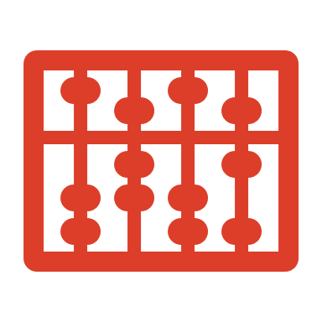
Cloud-native expectations
Scalability
Integration
Application vs infrastructure concerns
Polyglot

Slide 6
Challenges with microservices
Where is the application going to run?
Specific infrastructure
Limited portability without rewrite
What platform/framework to use?
Limited language support
Tightly controlled feature sets
Multiple integration points and targets
Tracing
Configuration
Queues
3rd party APIs
Coupled to specific service and SDK

Slide 7

Distributed Application Runtime
Event-driven, portable runtime for building microservices on cloud and edge.
https://dapr.io

Slide 8
Dapr building blocks
Service-to- service invocation
State management
Publish and subscribe
Bindings
(input/output)
Actors
Observability
Secrets
Perform direct, secure, service-to-service method calls
Create long running, stateless and stateful services
Secure, scalable messaging between services
Trigger code through events from a large array of inputs
Input and output bindings to external resources including databases and queues
Encapsulate code and data in reusable actor objects as a common microservices design pattern
See and measure the message calls across components and networked services
Securely access secrets from your application

Slide 9

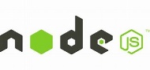



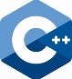

Any language and framework
Standard APIs accessed over http/gRPC protocols from user service code
Runs as local “side car library” dynamically loaded at runtime for each service
Application code
Microservices written in
Any code or framework…
HTTP API
gRPC API
Service-to-service invocation
State management
Publish and subscribe
Resource bindings and triggers
Actors
Observability
Secrets
Extensible

Slide 10
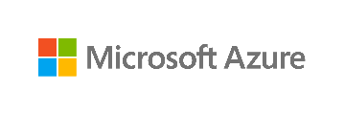



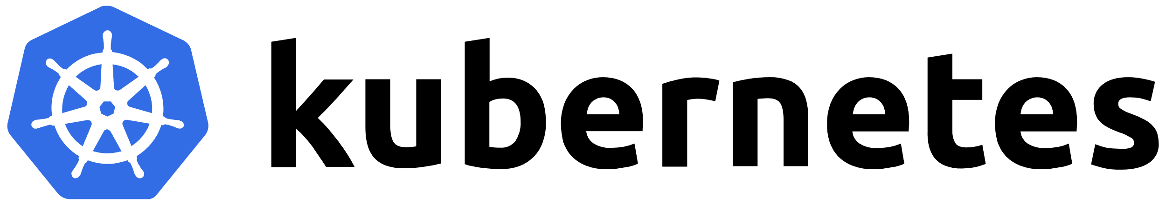


Any cloud or edge infrastructure
Application code
Microservices written in
Any code or framework…
HTTP API
gRPC API
Service-to-service invocation
State management
Publish and subscribe
Resource bindings and triggers
Actors
Observability
Secrets
Extensible
Hosting infrastructure
Azure Arc
On-Premises

Slide 11
Building blocks
HTTP API
gRPC API
Service-to-service invocation
State management
Publish and subscribe
Resource bindings and triggers
Actors
Observability
Secrets
Extensible

Slide 12

Sidecar demo Echo app
Dapr cli
Visual Studio Code Http Rest extension
Application
Dapr sidecar
Echo App
Dapr API
HTTP/gRPC
GET http://localhost:3500/v1.0/invoke/echo/method/ping/hi there sidecar!

Slide 13


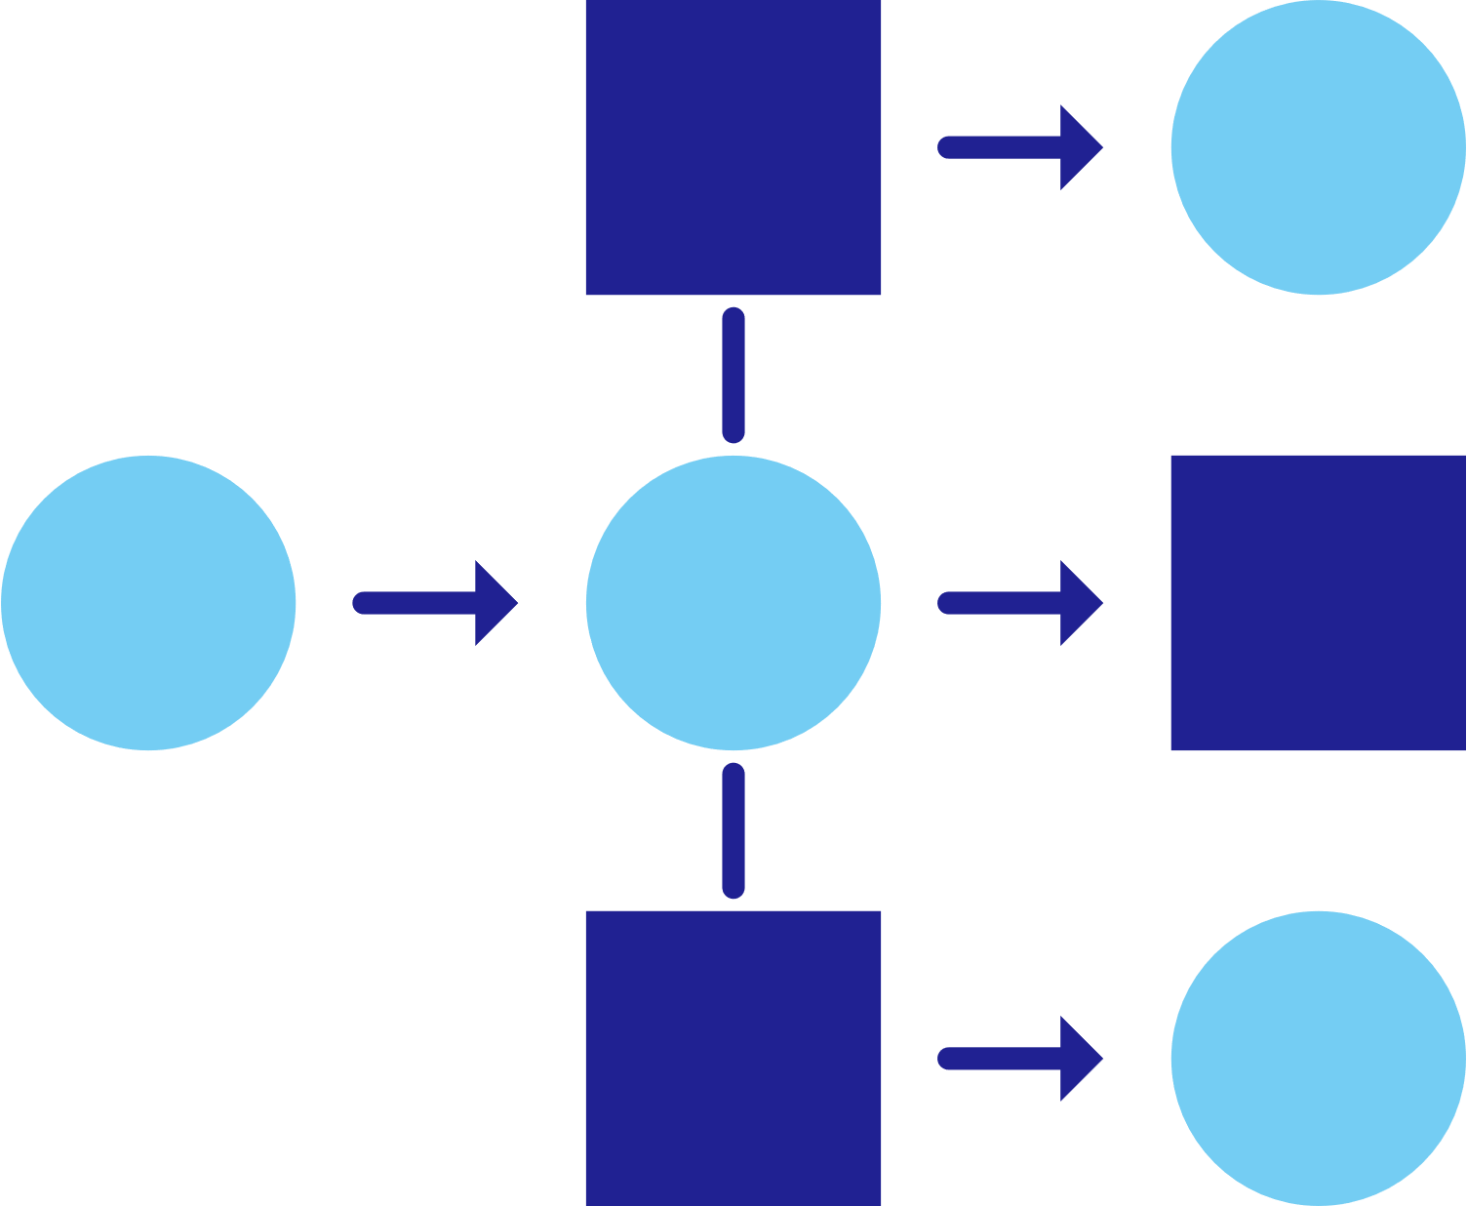
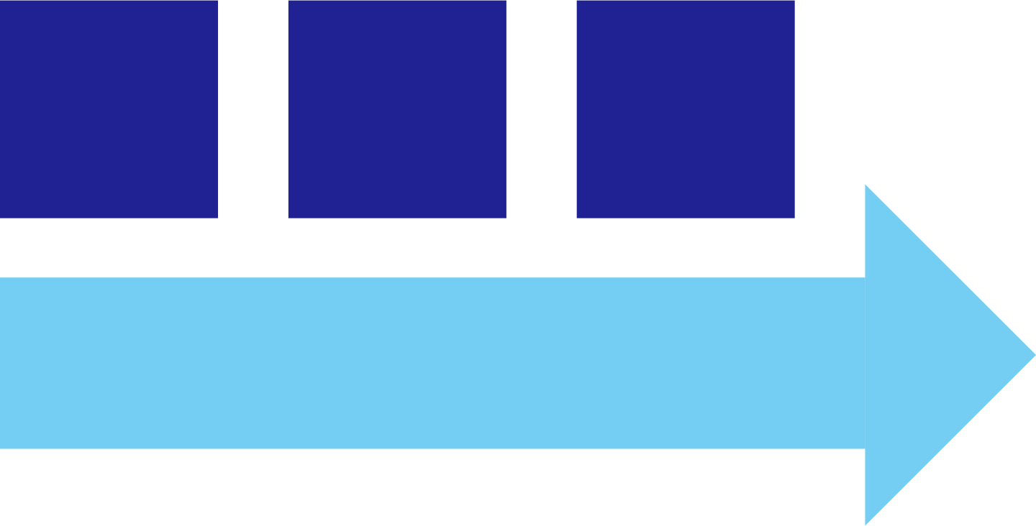



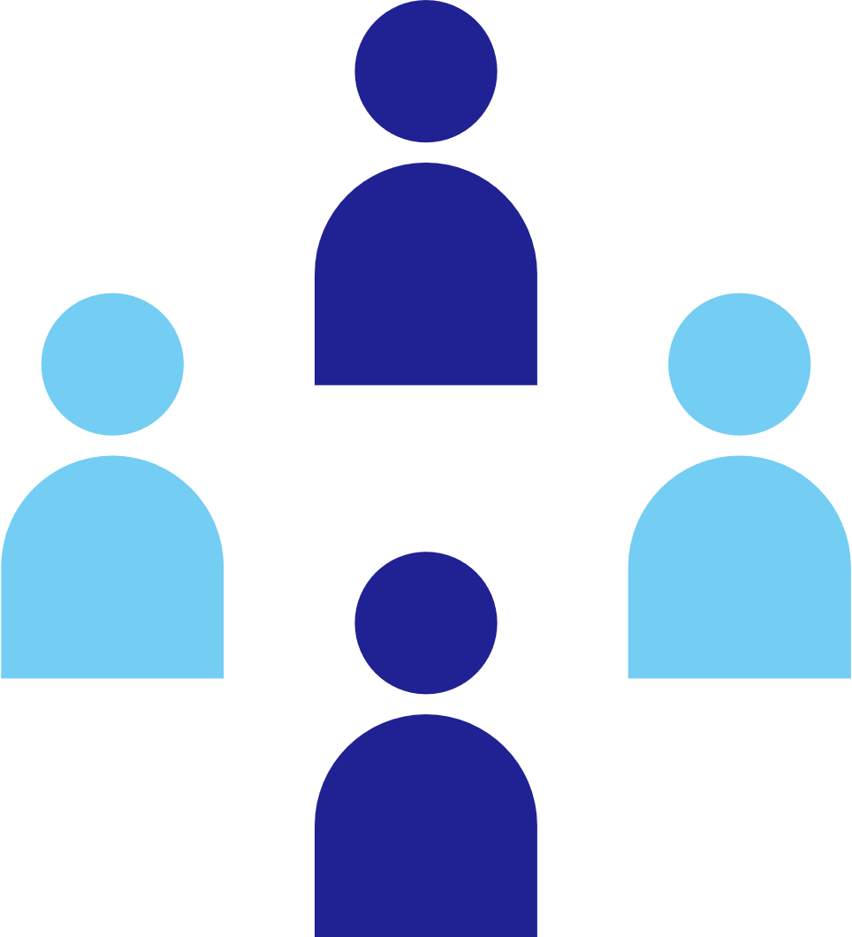
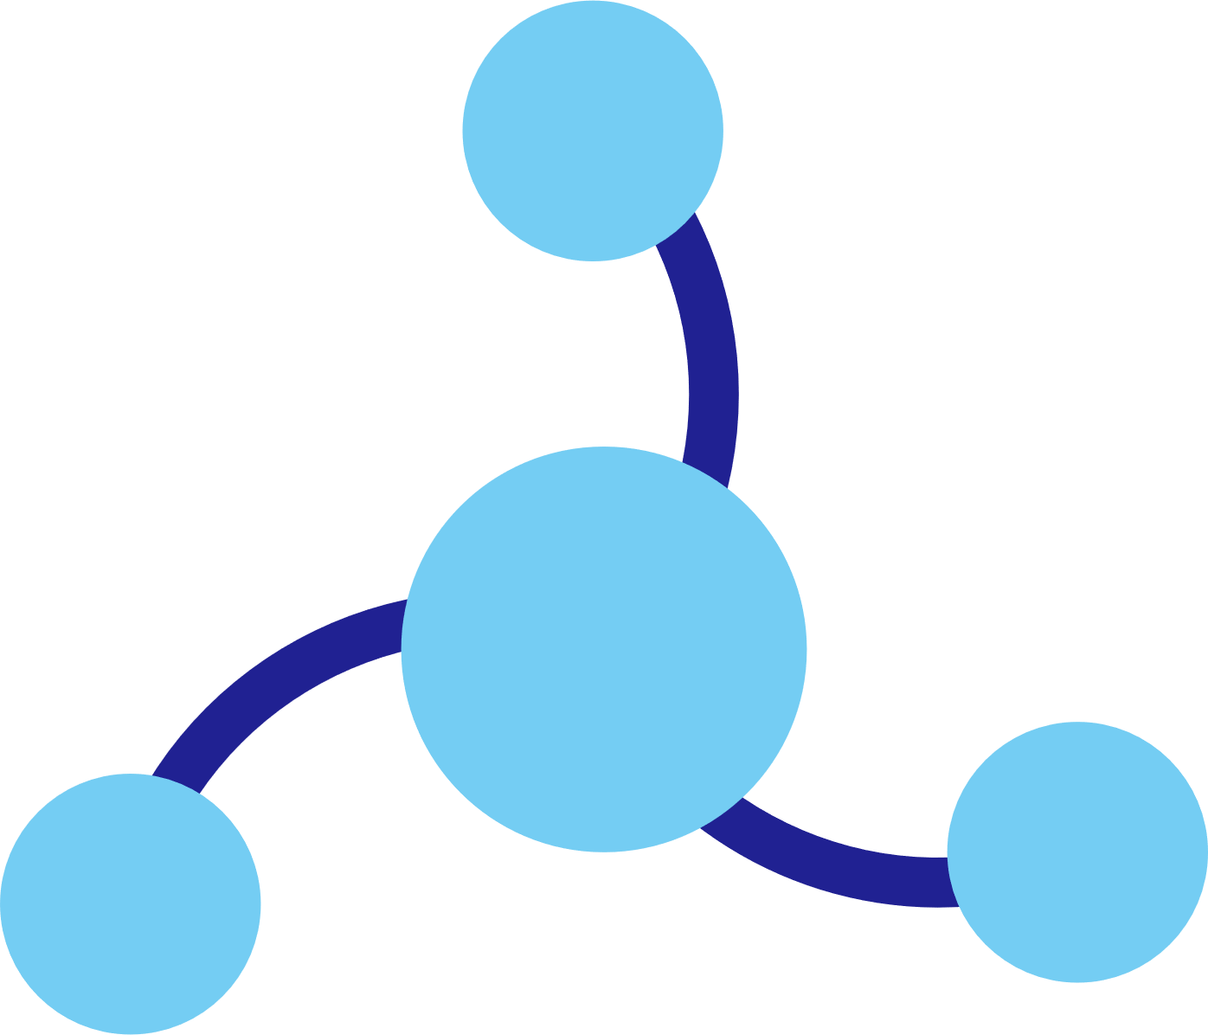
Dapr applications
Service A
State
Management
Service
Invocation
My App
PubSub
Messaging
Bindings
& Triggers
Secret
Management
Virtual
Actors
Service B
Observability

Slide 14





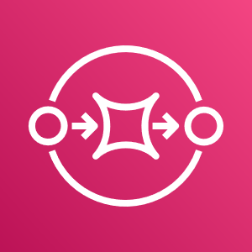









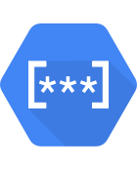



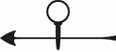

Dapr components
State
Stores
AWS
DynamoDB
Azure
CosmosDB
Firebase
Redis
Cassandra
PubSub
Brokers
AWS
SQS
Azure
Service Bus
GCP
Pub/Sub
Redis
RabbitMQ
My App
Bindings
& Triggers
AWS
S3
Azure
Storage
GCP
Storage
Twilio
Kafka
Swappable YAML files with
resource connection details
Over 70 components available
Create components for your resource at: github.com/dapr/components-contrib
Secret
Stores
AWS
Secrets Manager
Azure
KeyVault
GCP
Secret Manager
HashiCorp
Vault
Kubernetes
Secret
Observability
Prometheus
AppInsights
Zipkin
Jaeger

Slide 15
Sidecar model
Application
Dapr sidecar
My App
Dapr API
HTTP/gRPC
POST http://localhost:3500/v1.0/invoke/cart/method/neworder
GET http://localhost:3500/v1.0/state/inventory/item67
POST http://localhost:3500/v1.0/publish/shipping/orders
GET http://localhost:3500/v1.0/secrets/keyvault/password

Slide 16







Dapr design principles
Building blocks
Platform agnostic cloud + edge
Consistent, portable, open APIs
Extensible and pluggable
Any language or framework
Standards based
Community driven vendor neutral

Slide 17

Blazor demo app
Building blocks:
Service Invocation
State Management
Publish and Subscribe
Secret store

Slide 18




Architecture
Pod
Service Invocation
CONTAINER
CONTAINER
Dapr
Dapr API
Blazor Frontend
Pod
State store
Pub Sub
CONTAINER
CONTAINER
Dapr
Dapr API
Favorites API
State management
Pod
CONTAINER
CONTAINER
Pub Sub
Dapr
Vacations API
Dapr API
Pod
CONTAINER
CONTAINER
Dapr
Order API
Secret Store
Dapr API

Slide 19
Let’s dive into the source code
Building blocks:
Service Invocation
State Management
Publish and Subscribe

Slide 20

Dotnet Hot reload
Tye is running ‘dotnet watch run’ instead of ‘dotnet watch’ which is not enabling hot reload
Solution: run dapr cli manually
Visual Studio Code launch shell extension

Slide 21
Deploy to Azure Kubernetes Service
Tye deploy

Slide 22

Diagnostics
Dapr dashboard
Distributed tracing
Zipkin
Application Insights
Grafana dashboard

Slide 23
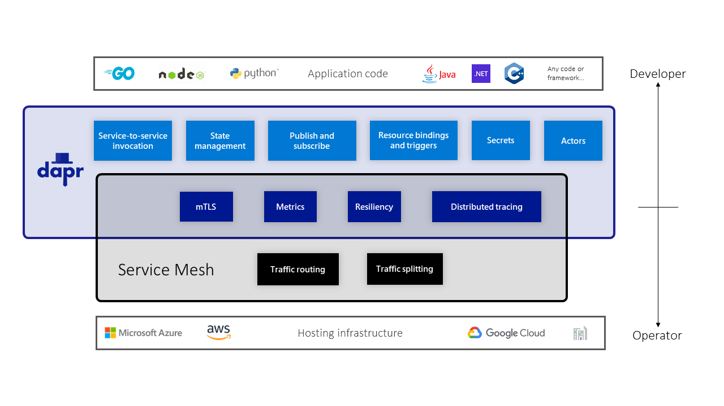
Dapr is not a Service Mesh
Tracing
Favor Dapr. Service Mesh only traces http
Metrics
Enable for both
Aggregated
Prometheus pulls
Shows bottlenecks in Service mesh and Dapr
Resiliency (retries, circuit breakers)
Retries:
Service mesh: per endpoint
Dapr: per call
Circuit breakers:
Not always present in service meshes (Linkerd / istio)
mTLS
Interchangeable. Dapr does not provide permissive mode

Slide 24
Considerations
Dapr v1.0 released February 2021
Dapr v1.7 but many components still alpha
Beyond key/value pairs:
Odata queryable table store building block in alpha stage
Relational data or graph data out of scope
Calls over highly-performant gRPC
Yet another layer of abstraction
Leaky abstractions

Slide 25
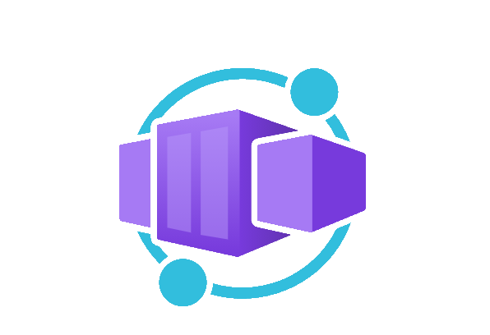
Azure Dapr support
Authentication
Azure Functions runtime (preview)
API Management self-hosted gateway
Container Apps
Public Preview
Kubernetes made easy
Built-in Dapr support
Service Discovery cross-resources? HashiCorp Consul?

Slide 26
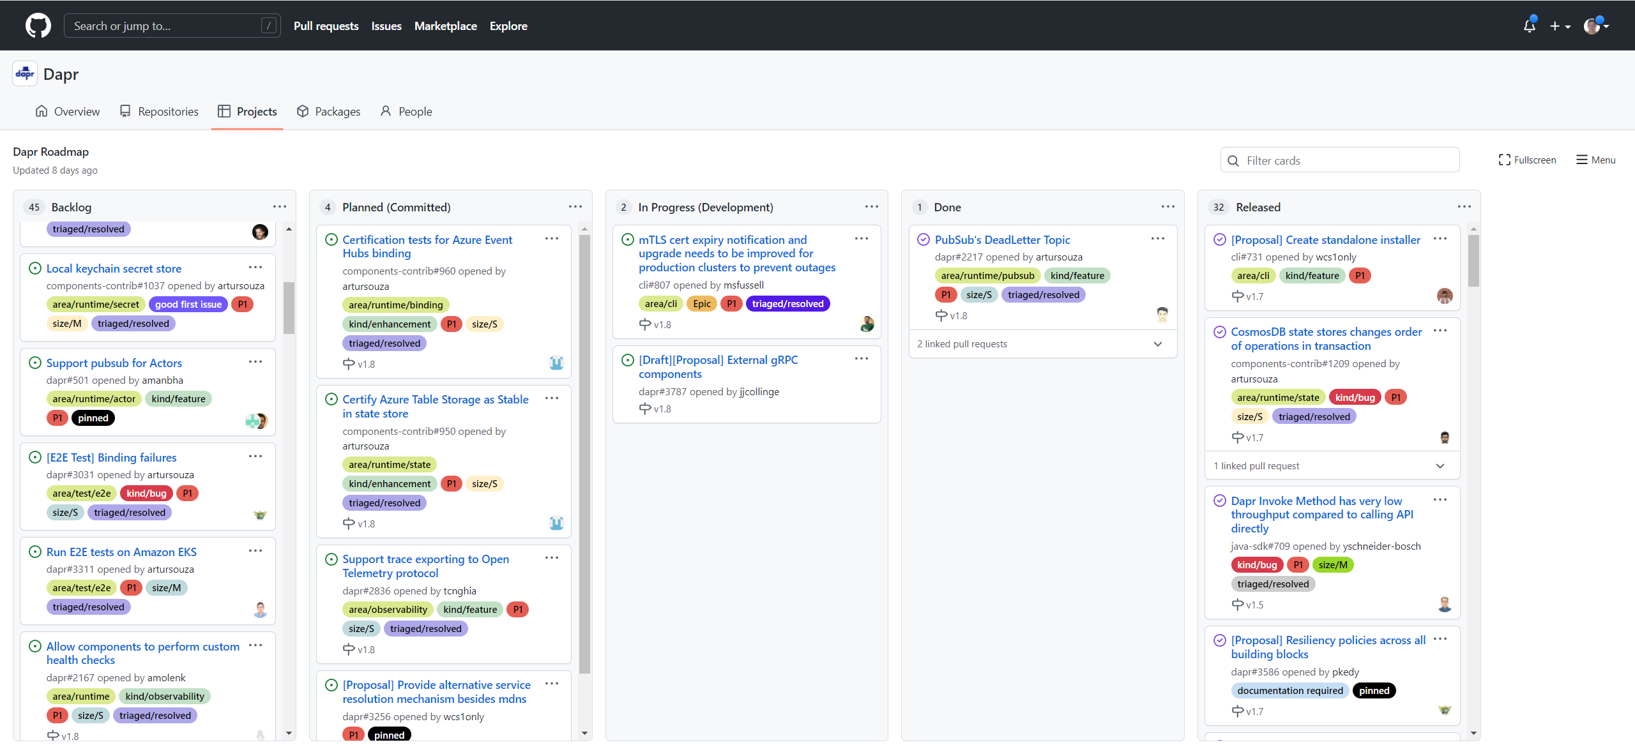
Roadmap
Workflow building block
Subscriptions for Virtual Actors
Notes:
https://docs.microsoft.com/en-us/dotnet/architecture/dapr-for-net-developers/summary

Slide 27




Wrapping up
To get started go to: https://www.dapr.io/
Let’s connect!
Demo code and presentation:
https://github.com/cveld/BlazorDaprDemo
@cveld
carl@intveld.nl
https://www.linkedin.com/in/carlintveld/

Slide 28
Thanks for your attention!
Company/speaker
Presentation title
#teqnation2022
#teqnation2021

Slide 29
Other topics
Virtual actors
Authentication
Middleware
Azure Container Apps

Slide 30
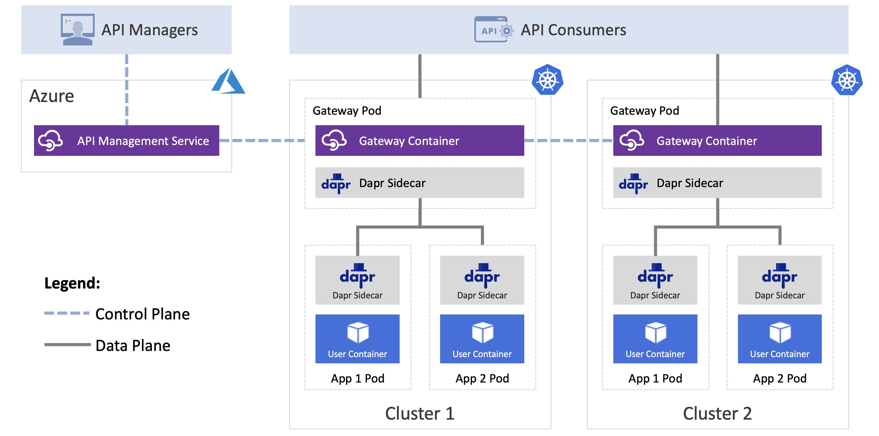
API Management

